Slide 1

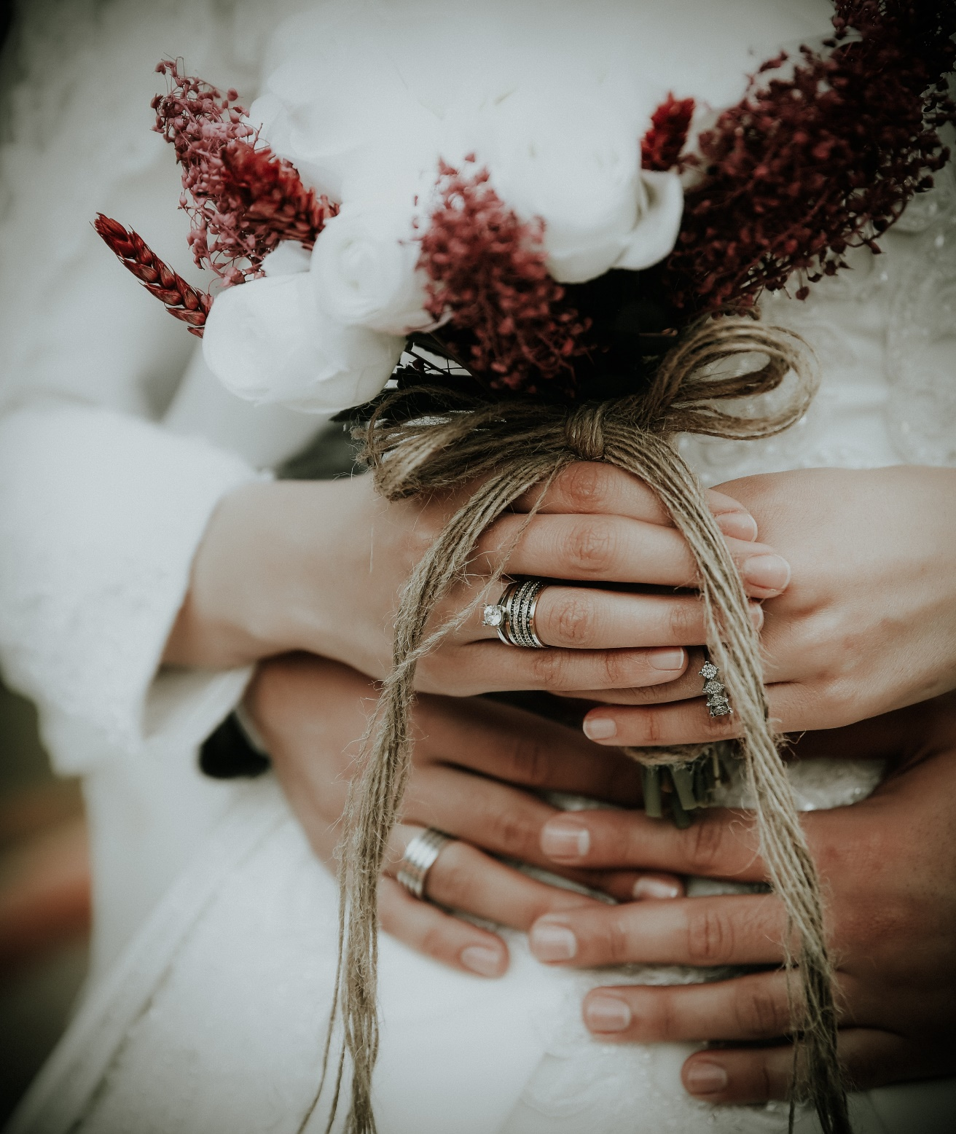
FARAH
The joy of joy

Slide 2
Agenda :
Introduction.
Business requirements.
User goals.
Empathy map.
User flow.
Wireframe & prototype.

Slide 3
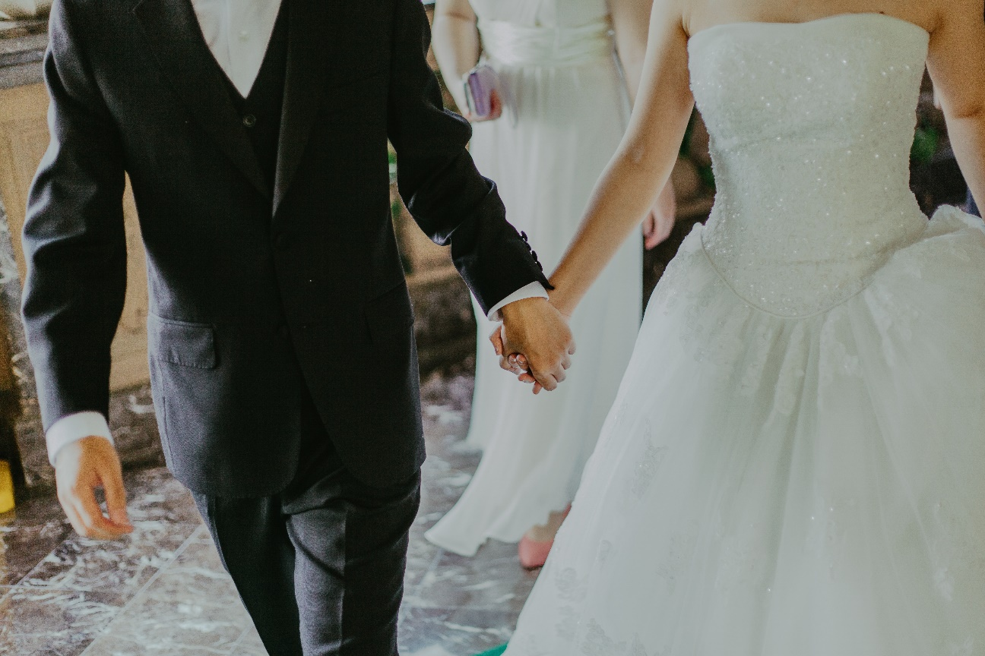
Introduction
Let’s see.

Slide 4
What about farah ?
website for wedding planner that help the bride to book for her bridal with comfortable and confidence with good budget and high quality with the perfect style that she need exactly .

Slide 5
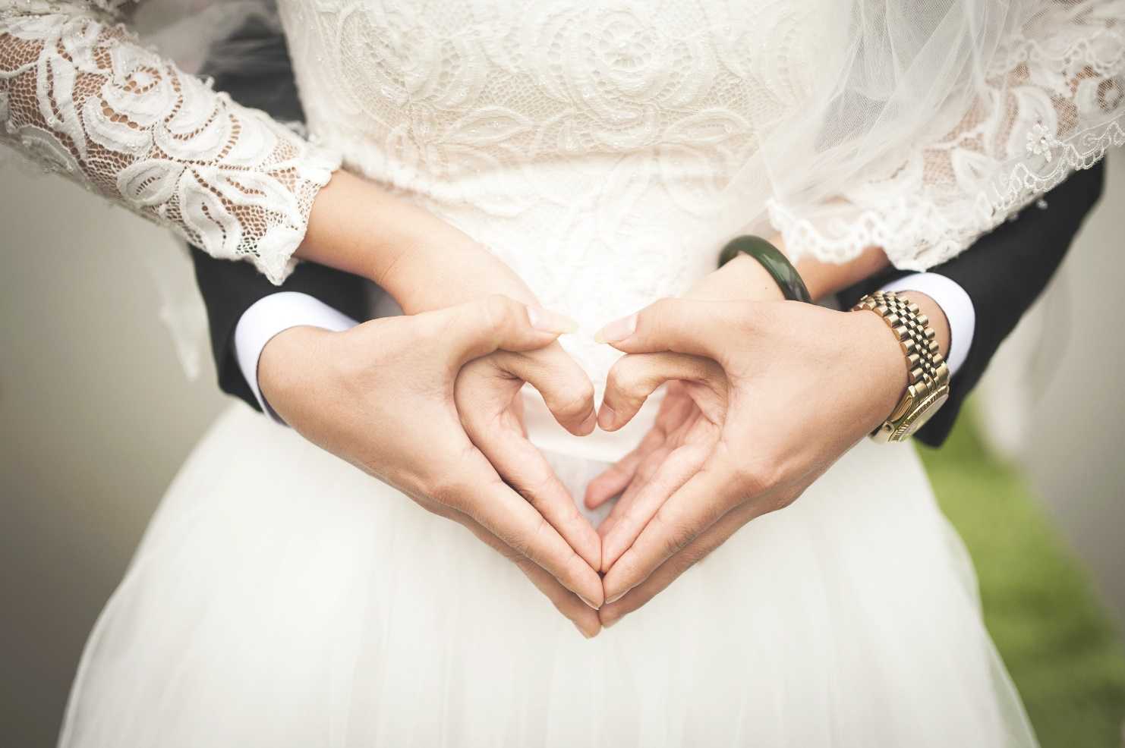
Business requirements
Let’s see.

Slide 6
What are the goals of the project ?
Marketing the wedding hall , open air places , , photographers
Provide reservation online for users instead of their fatigue.
Attract the brides attention to the website.
Profit through advertising

Slide 7
What does success look like?
Increase the income by 10% per year.
Increase the reservation rate of the site by 20%
Get good feedback from customers.

Slide 8
Who the users can use this site?
The brides from 20 to 35.

Slide 9
Why will they use this site ?
Support the brides with a lot of package for their wedding party.
Reserving their wedding hall online instead of watching a lot and wasting a lot of time and many too.
Help bridal for reserving their best photographer ,wedding cakes , invitations.
Fast customer services support.

Slide 10
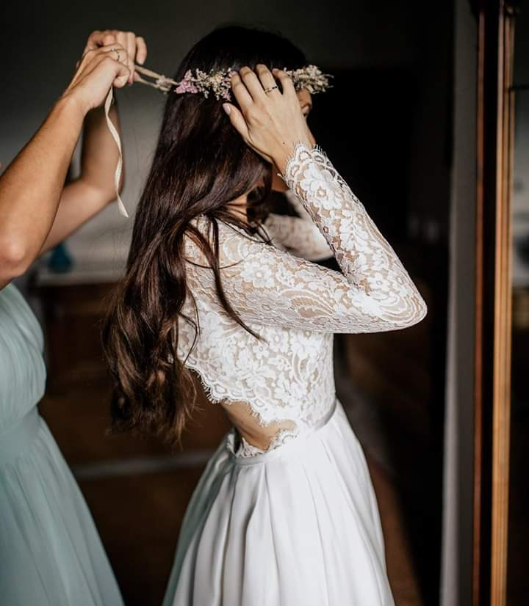
User goals
Let’s see.

Slide 11
What’s the role of wedding planner from their own point?
Wedding planner help couples successfully plan their wedding day and see that every thing runs smoothly, your responsibilities include establishing a planning timeline and working with the bride and groom to choose everything from attire, to ceremony and reception venue , music and cakes.

Slide 12
2. What makes a good wedding planner ?
Good wedding planner possess excellent interpersonal skills that aid their when interacting with all parties involved. They should be friendly , outgoing and willing to work under pressure. Additionally wedding planners must have excellent communication skills to negotiate with vendors and merchants.

Slide 13
3. What should you expect from wedding planner?
interest about what the bride and groom want exactly.
Coordinate during the whole day.
Time management.
Appropriate budget.
Interest about small details.
Do his best to make the bride more happy on her day.
Good service.
How deal with all risk may happen in bridal.

Slide 14
4. What the most thing they need from wedding planner?
Insure that the wedding day would be perfect.
5. How they know about wedding planner ?
By advertisements in social media.

Slide 15
6. What is the problem they can meet?
Service is bad.
Prices are expensive
Hearing about many features but when he visit this site he can’t found any thing.
More search that waste his time.
Many brides can’t found good makeup artist they need or photographer who has skill they need.
difficult to find who cat care about their details they need.ٍ

Slide 16
user goals
Provide good offers
Good service.
Facilitate the search method
Existence of previous work to ensure the service
Provide more than one payment method

Slide 17
The user is the groom and the bride who wants to organize a good wedding with a good price

Slide 18
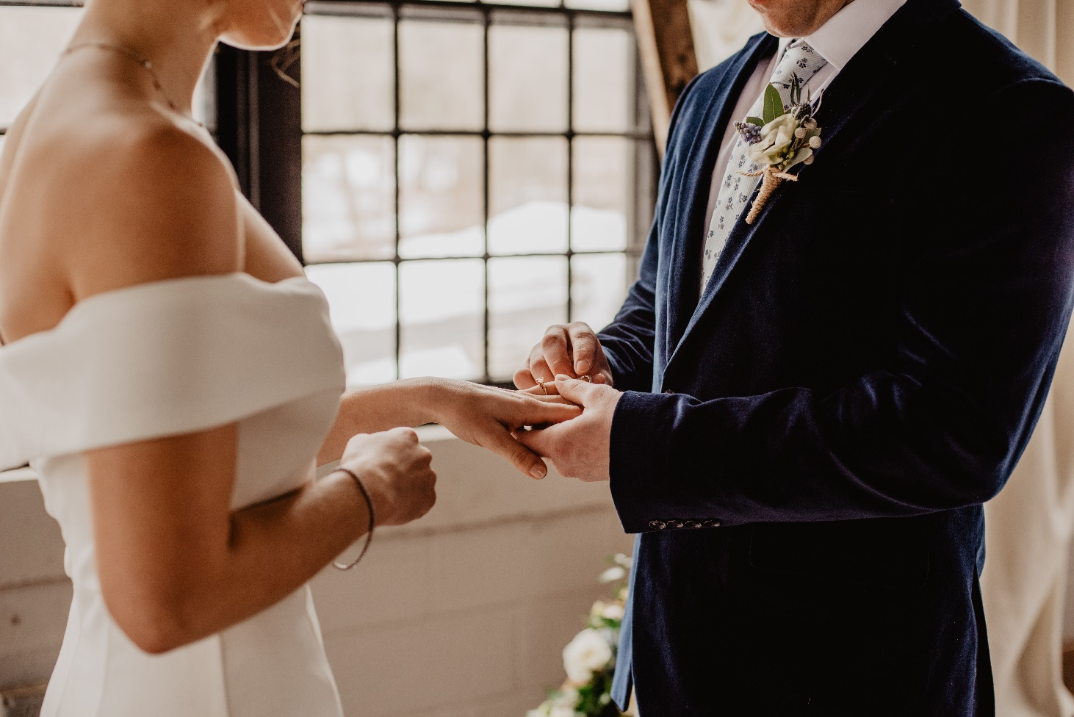
User persona
Let’s see.

Slide 19
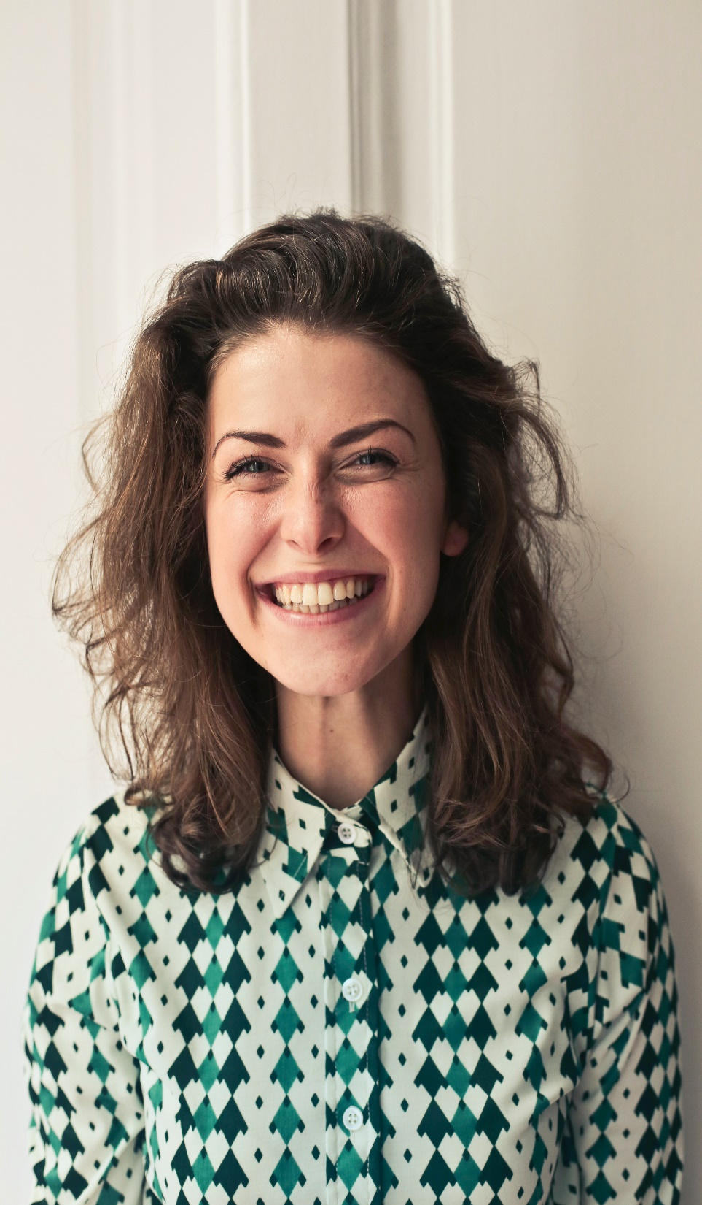
name: Lina.
Age: 25.
Salary: 6000 EP.
Job: Fashion blogger.
Status: Betrothed.
Application:
Facebook , Twitter , WhatsApp .
Hoppy:
Playing tennis, reading.
Which time do you browse the internet and watch advertisements and videos ?
In weekend.
Do you deal with wedding planner before ?
Yes , to book for my wedding day near.
How do you know about wedding planner ?
By browse the internet.

Slide 20
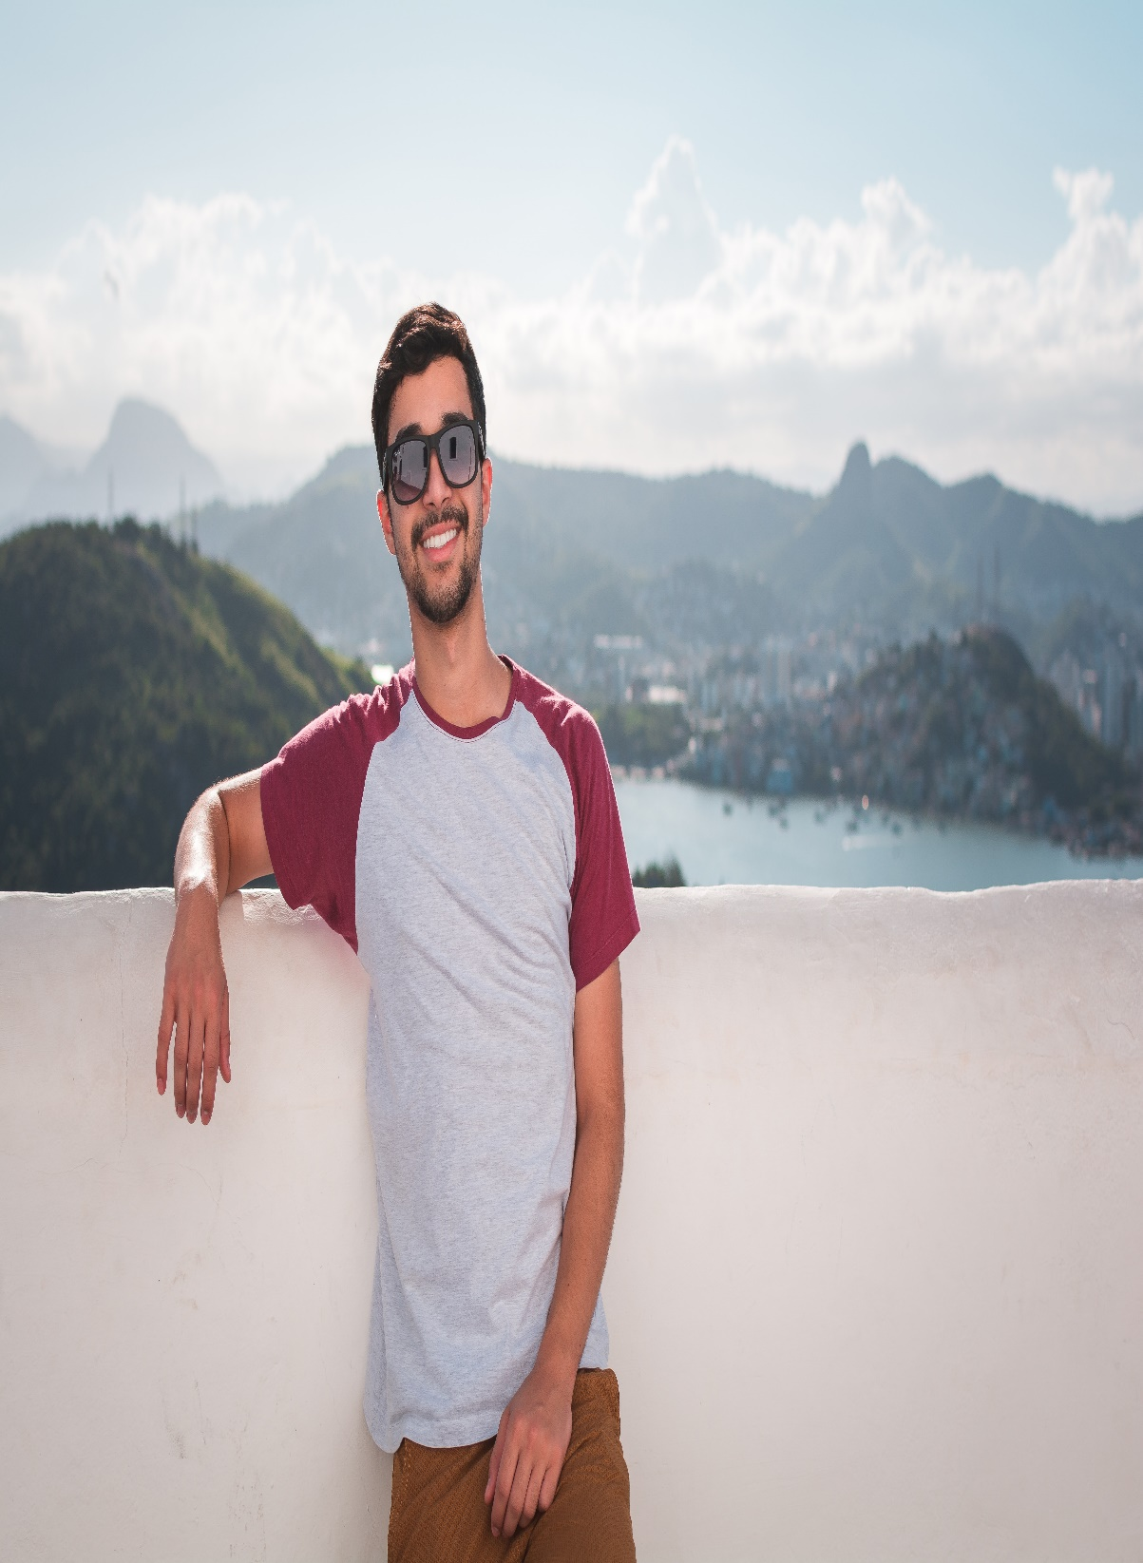
name: Rayan.
Age: 28.
Salary: 8000 EP.
Job: engineer.
Status: Married.
Application:
Facebook , Twitter , Instegram .
Hoppy:
Playing tennis , reading , travelling , browes the internet.
Which time do you browse the internet and watch advertisements and videos ?
All time.
Do you deal with wedding planner before ?
Yes , during booking fo my weeding day.
How do you know about wedding planner ?
My friend advise me to communicate with wedding planner.

Slide 21
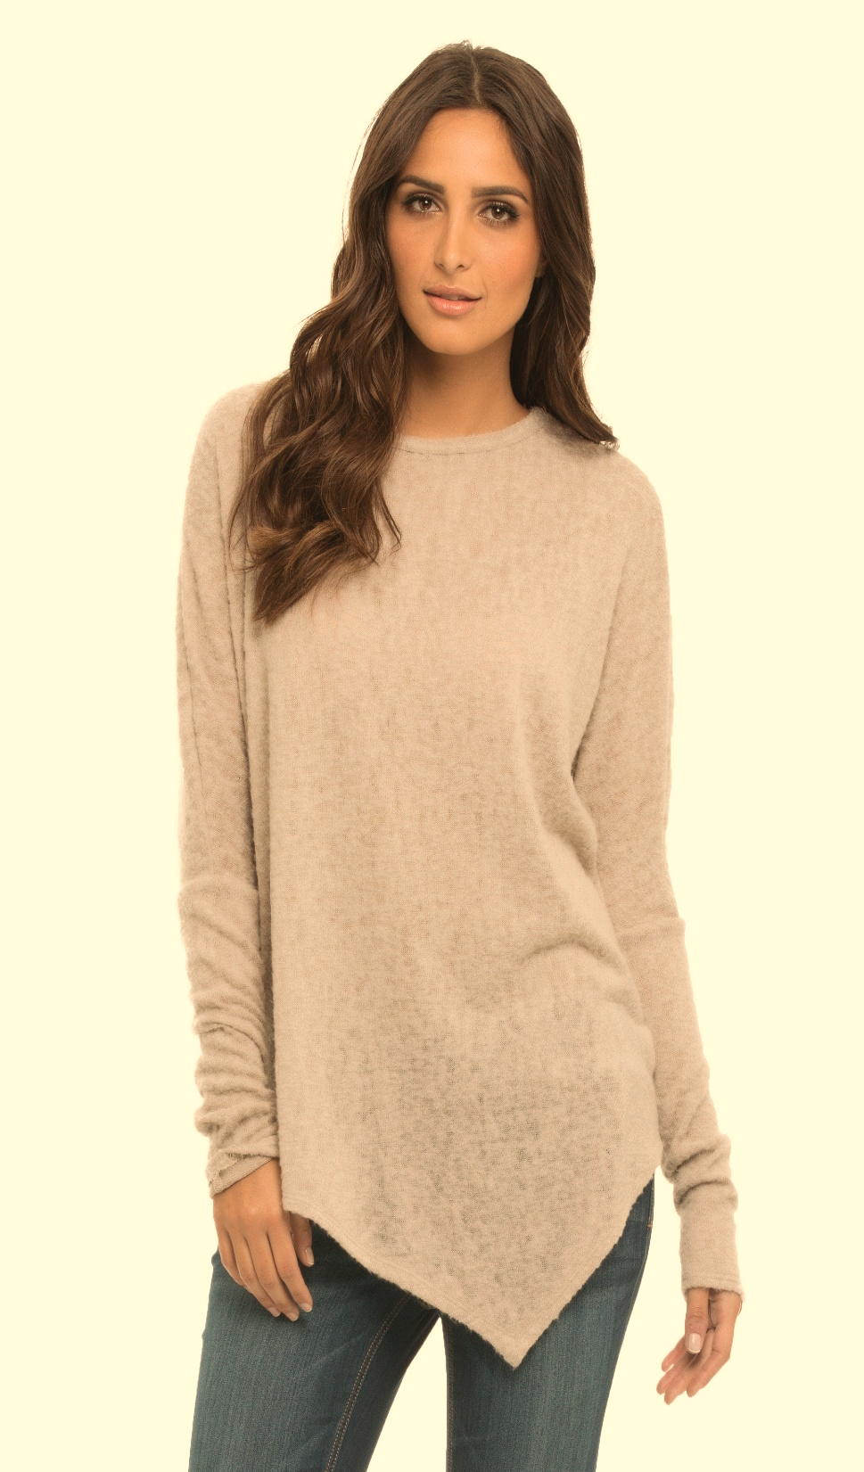
name: Rema.
Age: 33.
Salary: 5000 EP.
Job: stylish.
Status: Married.
Application:
Facebook , Twitter , Instagram , whatsApp.
Hoppy:
reading , travelling , browes the internet , running.
Which time do you browse the internet and watch advertisements and videos ?
On my free time through the day.
Do you deal with wedding planner before ?
yes . Through my weeding .
How do you know about wedding planner ?
by watching advertisements on internet.

Slide 22
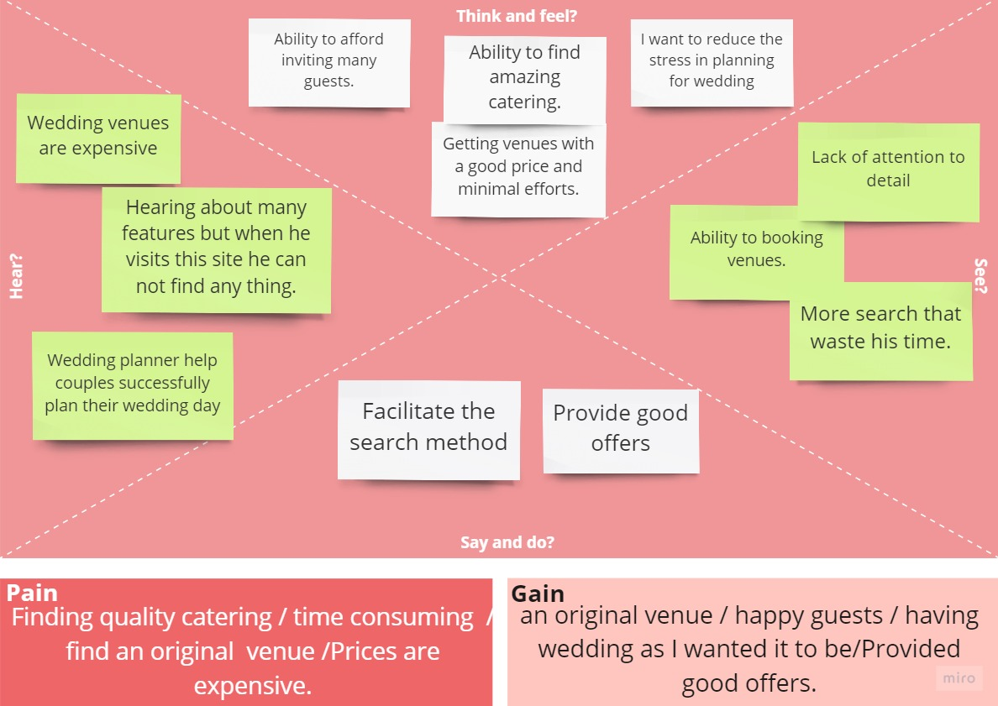
Empathy Map

Slide 23

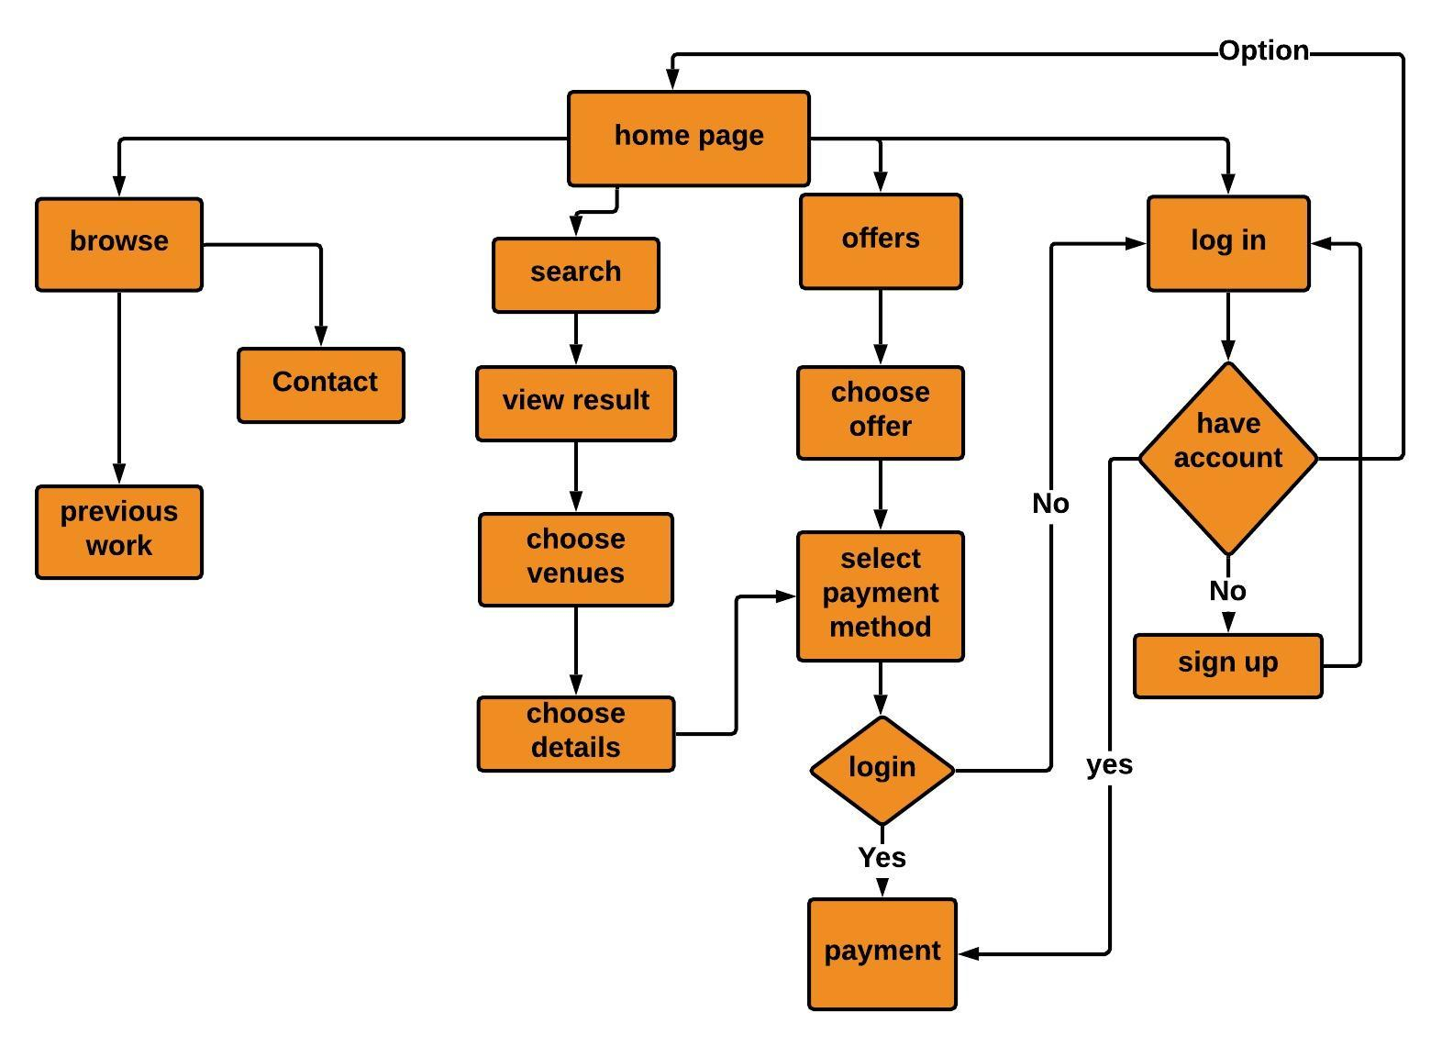
user flow

